Slide 1
Financial Trend Analysis
Jay Pandya

Slide 2
Does WellsFargo (WFC) and General Motors (GM) behave similarly?
Strategy:
Preliminary Analysis
Classify stocks in appropriate buckets based on their trend
Correlate stock behavior with the behavior of the overall market, its associated industry, and supplementary market forces
Group stocks using above features
Notes:
We expect stocks in the same industry to behave similarly, but do stocks in different industries behave at all similarly?

Slide 3
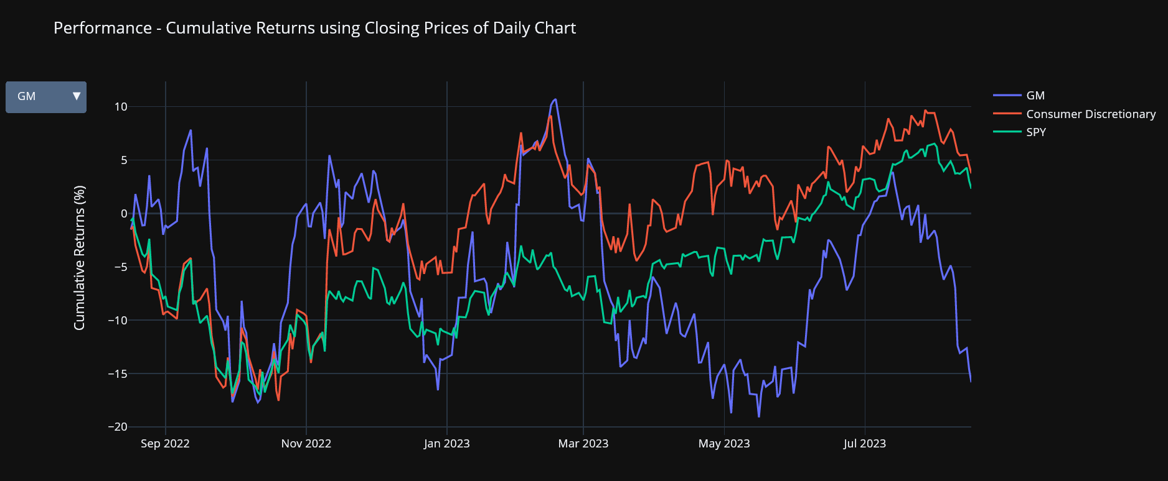
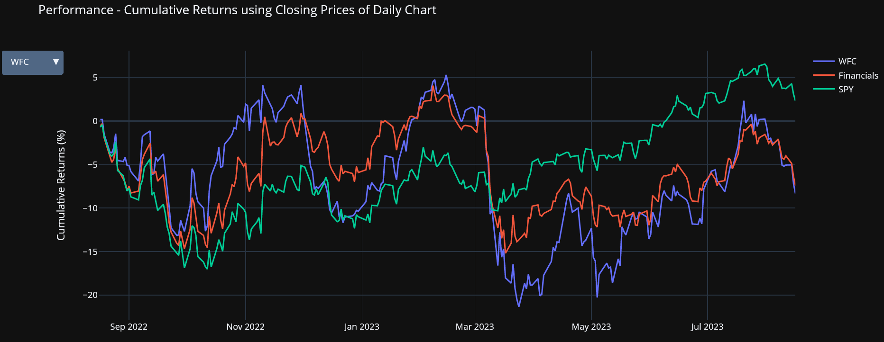
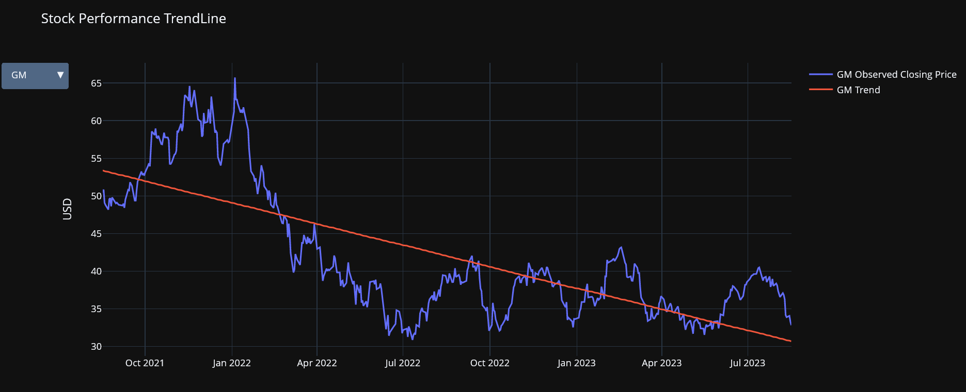
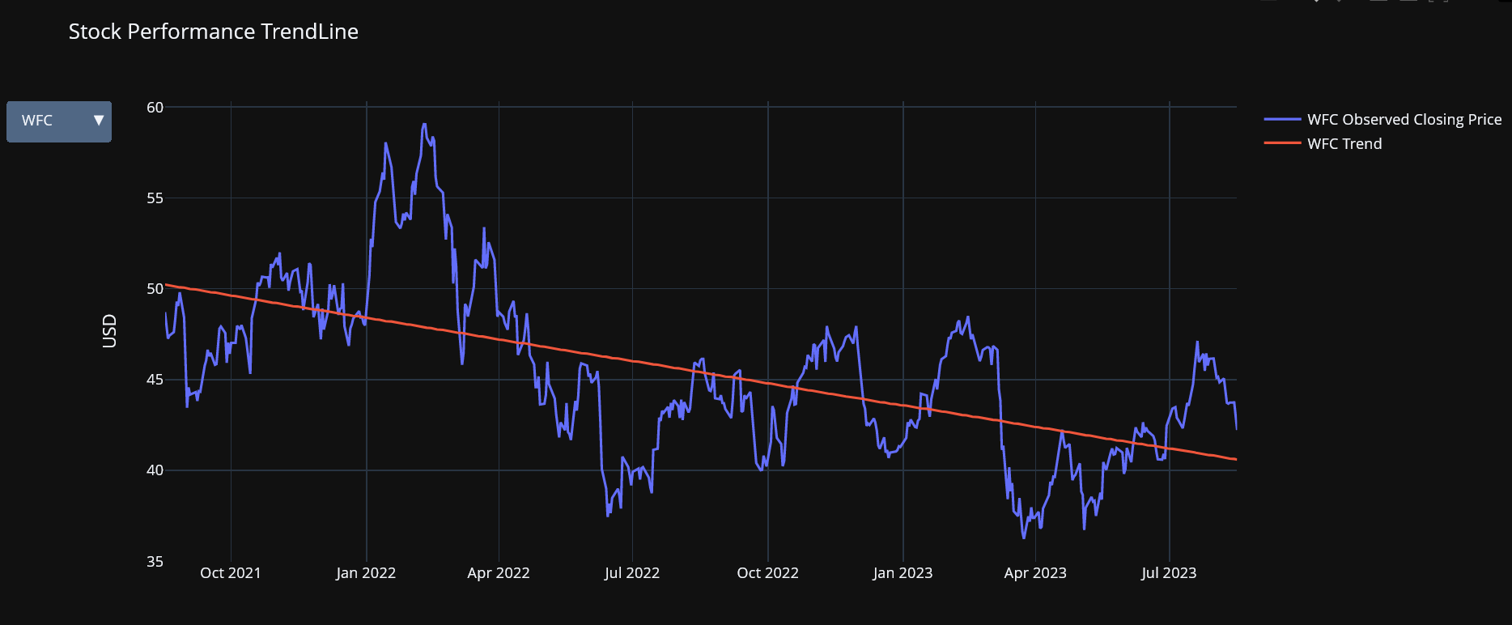
Preliminary Analysis
GM
WFC
Notes:
Our strategy is to:
1. Perform a preliminary visual analysis (see snp500_stock_performance.html file) of each stock over the past 1 year. We try to visually ascertain its yearly performance by calculating its return on investment and looking at its trend. We compare each stock’s performance and trend to the overall market and stock-specific-industry’s performance and yearly trend

Slide 4
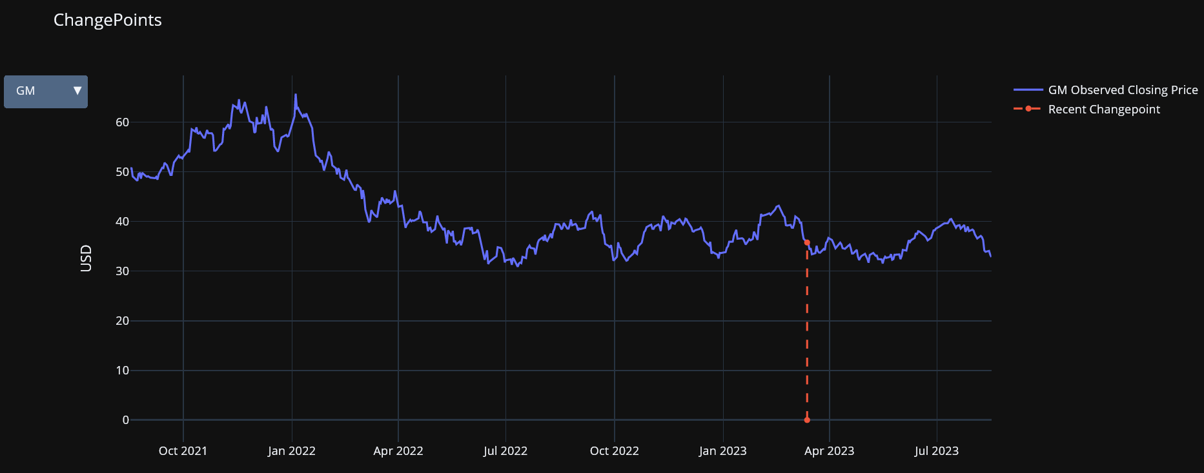
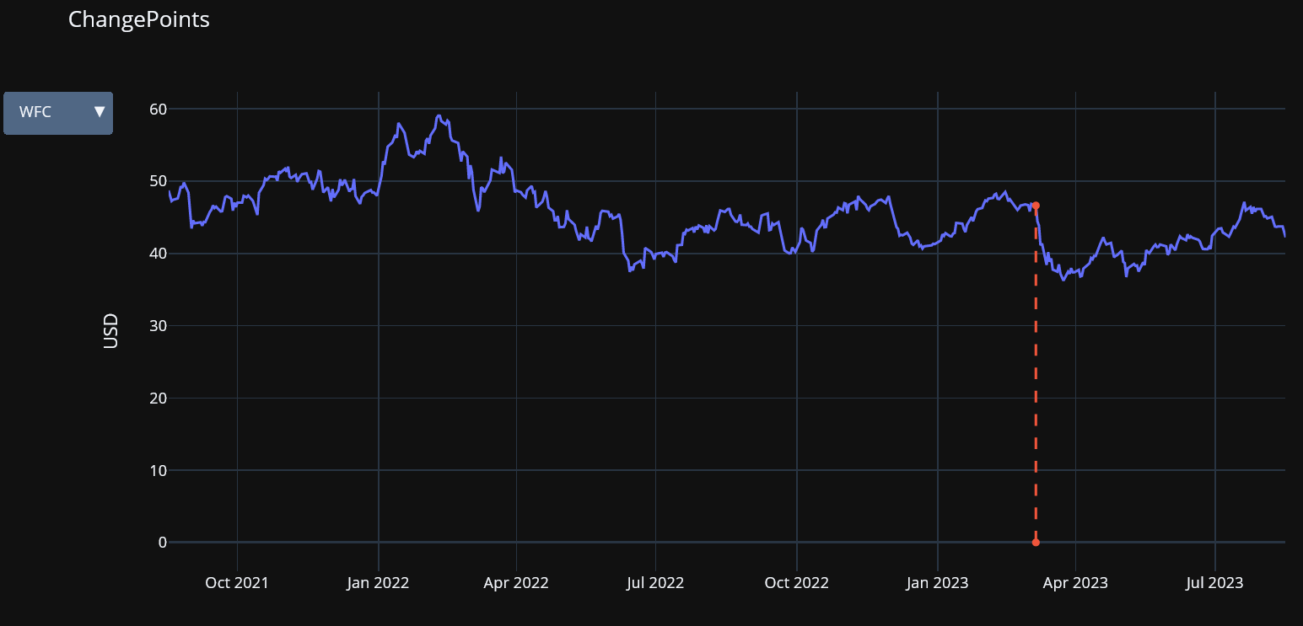
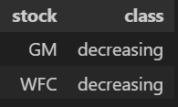
Trend Classification
GM
WFC
Notes:
2. We classify each stock based on its overall trend. Such classification is made automatically with a statistical model.
To be cognizant of temporary/recent change of trend (such as price shocks, or trend reversals), we categorize each stock into one of the following 6 buckets:
Increasing/RecentTrendChange, Inc/No-RTC, Dec/RTC, Dec/No-RTC, No-Change/RTC, No-Change/No-RTC.
A trend change is identified with a ChangePoint algorithm that automatically identifies points on the timeseries that statiscally seem to alter the segment’s trend.
In the above example, both GM and WFC seem to be decreaing

Slide 5
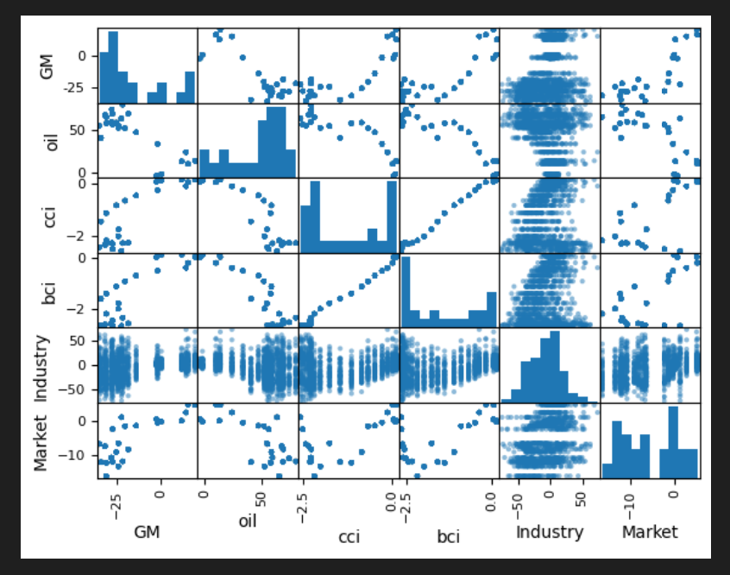
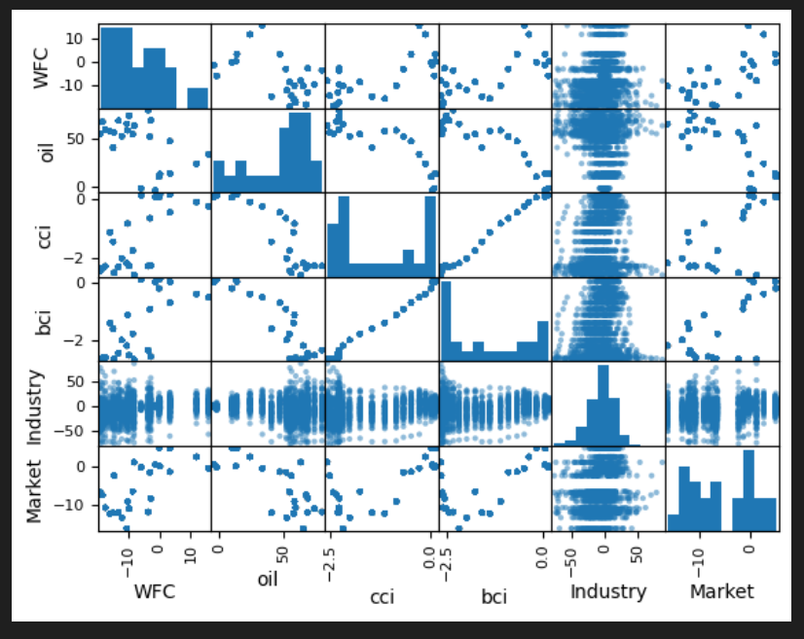
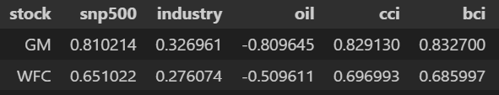
Stock Correlations
Notes:
3. We try and correlate the 2-year return-on-investment performance of each SNP500 stock with the overall market (SNP500), its associated industry (ex: for WFC, sector = Financials) and other market forces such as oil-and-gas index, consumer confidence index, etc.

Slide 6
Clustering
We cluster all SNP500 stocks using previously calculated trend and correlation based features.
Based on our analysis, it can be seen that
GM and WFC do show similar stock market behaviors despite being in different sectors.

